Slide 1
Chapter 1 Controlling Your Volume

Slide 2
Mobile Penetration
What do these mean?
In mid-2015, 13 countries with over 100 million subscriptions
Penetration rate – average # of cell phones per person
In mid-2015, worldwide total number of purchased cell phone subscriptions > 6.8 billion

Slide 3
Sharing Medium
How is it possible for both pairs to use the same wire without interfering with one another?
multiple access technologies
First phone call was made on October 9, 1876, by Alexander Graham Bell, over a two-mile wired stretch from Boston to Cambridge
Public Switched Telephone Network (PSTN)

Slide 4
Sharing by Frequency
frequency channels
Frequency Division Multiple Access (FDMA)

Slide 5
What is Frequency?
Audible frequencies = different pitches of sound
Measured in units of hertz (Hz) – number of cycles per second in a wave

Slide 6
Frequency Channels
Frequency is the resource split among different users
Each connection uses a different frequency channel, which encapsulates a range of frequencies, defining channel width
Thinking of channel as a pipe

Slide 7
Typical Wireless Frequency Bands
Millions of hertz - megahertz (MHz)
GSM: 900 and 1,800 MHz bands
Billions of hertz - gigahertz (GHz)
WiFi: 2.4 and 5.8 GHz bands
Highest frequency human can hear?
20 KHz (20,000 Hz)

Slide 8
Role of FCC
FCC (Federal Communications Commission) has been in charge of licensing spectra to service providers since 1934
Some portions of the spectrum, like the parts WiFi uses, are unlicensed and can be used by anyone
Most portions, including that for cellular, require a license (and fee) to use

Slide 9
Early Mobile Phone
1st mobile phone (1920s-30s) used FDMA
analog: signals traversed the air in their exact electrical forms
1946: 1st mobile phone network (termed Mobile Telephone Service) was introduced by Bell Telephone
0G (zeroth generation)
1973: Martin Cooper (and his team) at Motorola built 1st mobile handheld phone – DynaTAC (weighs ~2 lbs, costs $3K [in 1973], offers 30 minutes of call time)

Slide 10
Invention of “Cell” Phone
Two options to increase network capacity
(1) more spectrum
(2) fit more users into same spectrum (how?)
When signals propagate through air (and wire), their power levels attenuate – diminish with further distance
Attenuation - good or bad?
(2) Divide regions into cells
frequency reuse
cause signal to weaken; make it harder to transmit over long distance
when far enough, two calls without overlapping in space

Slide 11
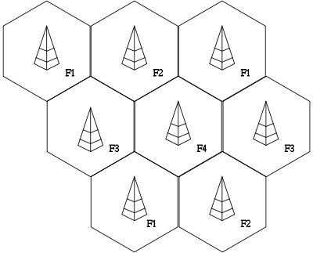
Cells
Hexagon shaped cells
A cell is assigned a set of frequencies (channels) not being used by adjacent cells
cells that are using the same frequencies will be far enough away from each other that it won’t matter
allowing more efficient utilization of available resource (spectrum)
example of one frequency per cell
Base station (BS) and mobile station (MS)
1G (analog and FDMA)

Slide 12
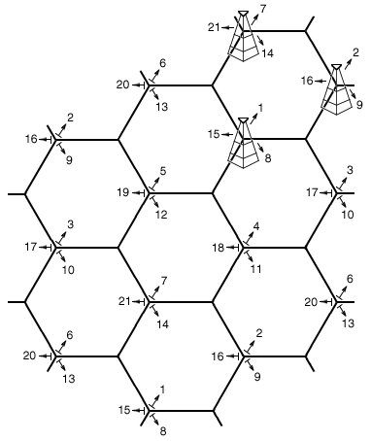
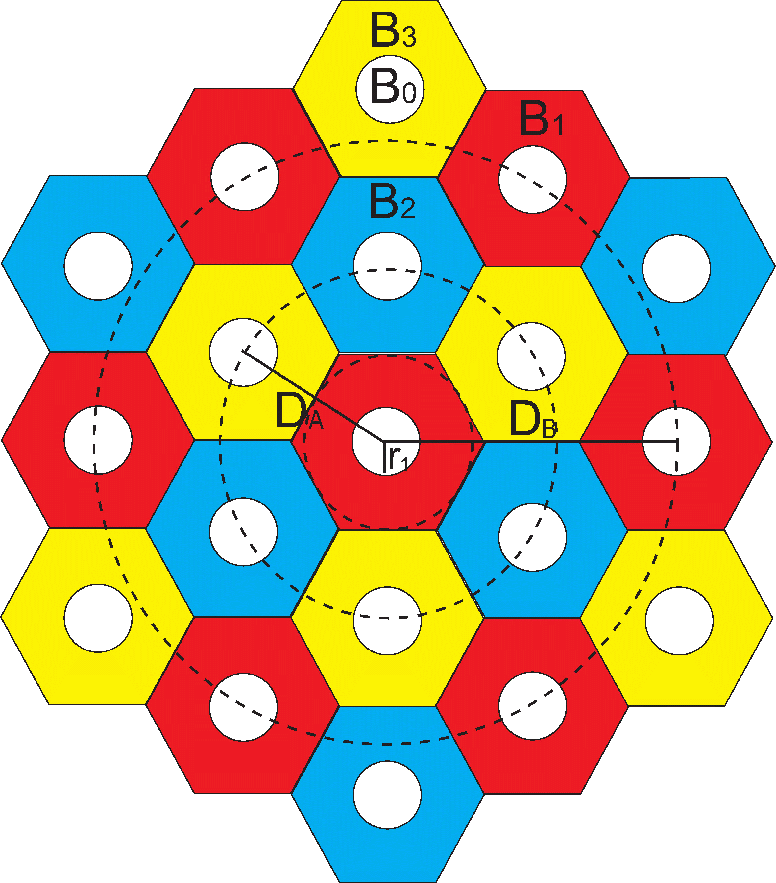
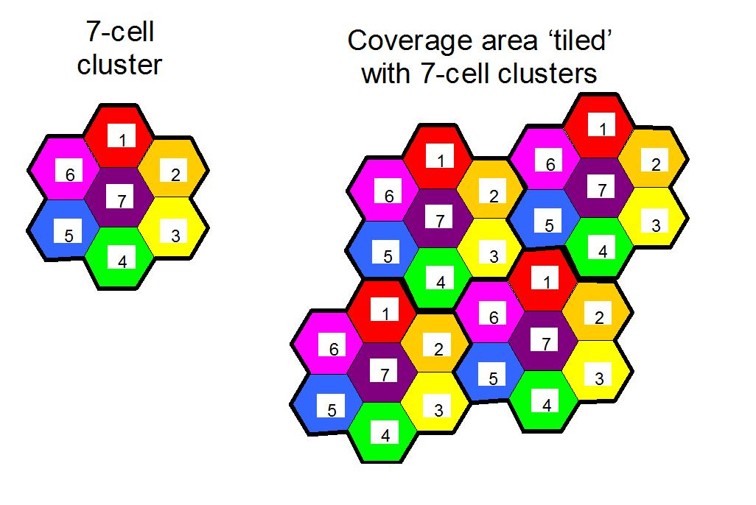
Example Cells
e.g., 3 frequencies per cell with directional antenna
Frequency assignment – how?
graph coloring problem
when assign colors (frequencies) to cells, use smallest number of colors possible

Slide 13
Digital Cellular
Analog signals traversed air in their exact electrical forms
Analog signal varies continuously in time
Analog signal is “digitized” into sequence of 1s and 0s, before transmission
Digital system enables two other multiple access technologies to increase capacity

Slide 14
Sharing by Time
Time Division Multiple Access (TDMA) (over one frequency channel)
frequency
time
TDMA + FDMA
2G: GSM (Global System for Mobile Communications)
- 900 and 1,800 MHz bands

Slide 15
Sharing by Language (Code)
Chinese
Spanish
Code Division Multiple Access (CDMA)
championed by Qualcomm

Slide 16
CDMA
Code like key
sender locks message
receivers unlocks with same key
noise when unlocked with other key
orthogonal codes used in one cell
Transmitter multiplies signals with spreading code (sequence of 1’s and -1’s)
Each bit in transmission is multiplied separately and sent as a much larger, composite stream
Once “coded” message arrives, receiver uses the same spreading code to recover the original message

Slide 17
CDMA
All calls may operate over the same frequencies and at the same time
3G: CDMA
4G: OFDM
5G
Beyond 5G
comparison

Slide 18

Cocktail Party Analogy
Capacity issue: to support more communicating parties
FDMA (room/cell)
TDMA
CDMA
One issue still?
When too many people are talking, you might not be able to hear your partner even when she is speaking the same language!

Slide 19
Near-Far Problem
Signals traveling at same time causes interference
complicated by distance
How can B, a mile from BS, make a call without it being ruined by A, a few meters from BS?
more attenuation and blockage
Channel quality

Slide 20
Solution to Near-Far Problem
Solution idea?
some mechanism to adjust transmit powers to compensate for differences channel quality
Transmission power control (TPC)
to equalize received signal powers
Basestation (BS)
measures what it was receiving from each transmitter
compares this with what it wanted to receive
sends a feedback message to each device telling them to adjust accordingly

Slide 21
Transmission Power Control
How is power measured at receiver?
Unit = watt (W) = the amount of energy transmitted per second
5 W = 5 joules of energy transferred per second
milliwatt (mW) and microwatt (μW)
Goal: to equalize received signal powers
Assume desired (received) power level at BS = 10 mW
Let A and B transmit at 10mW
TPC does
A: 2 X 10
B: 10 X 10
Next Power = “The Ratio” X Current Power
where “The Ratio” = desired power / received power

Slide 22
From Power to Quality
Objective of TPC: to equalize received signal power by boosting transmission power accordingly
Is TPC enough to ensure “good reception?”
Received signal is to be impacted by interference from other phones
impacts from many phones
Equalize “quality” (quality is more than power)

Slide 23
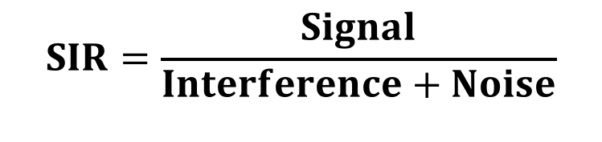
Received Signal Quality
What factors contribute to received signal quality?
received signal power from the desired transmitter which the receiver is trying to listen to
received signal power from the undesired (i.e., interfering) transmitters
receiver noise inherent in every receiver
How do you define “quality” ?
Quality = f(S, I, N)
Quality is measured as [good divided by bad]
Signal to Interference (& Noise) Ratio (SIR)
$$SIR=\frac{Signal}{Interference+Noise}$$

Slide 24
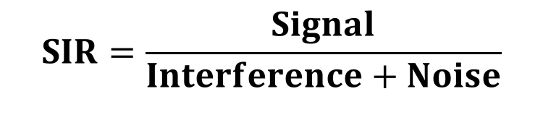
An Arms Race
Achieving target SIRs vs. achieving target powers - which one is more complicated?
Answer: target SIR- why?
cannot simply increase transmit powers to achieve all the desired SIRs simultaneously
$$SIR=\frac{Signal}{Interference+Noise}$$
↑ tx power of A
→ ↑ SIR of A
→ ↓ SIR of B
→ ↑ tx power of B
→ ↑ SIR of B
→ ↓ SIR of A
→ ………

Slide 25
Problem and Solution
If each device fixes a desired SIR, is it possible to find a set of transmit powers that will meet all of SIRs simultaneously?
Answer: yes, as long as desired SIRs are feasible or mutually compatible (i.e., there cannot be a collective desire for unrealistically high SIRs)
Solution: distributed power control (DPC)

Slide 26
Distributed Power Control (DPC)
Each devices starts with some initial transmit power
Receiver measures SIR for each transmitter
Based upon ratio between target and measured SIRs, each transmitter adjusts its power level
Repeat 2 and 3 as needed

Slide 27
Distributed Power Control (DPC)
Iterative algorithm (repeats over and over)
(near-far) TPC algorithm has single step
Given that target SIRs are feasible, DPC will converge, meaning that SIRs will be met by power levels that will stop updating
Convergent power levels will also be optimal ones, in the sense that they will use the least amount of energy

Slide 28
Example
3 MSs (A, B, C) in a single cell
Channel gain: a measure of how much power is amplified (fractional quantity → attenuated)
direct channel gain
interference channel gain
Target SIRs
Receiver noises
(Desired SIR)

Slide 29
Example
Consider link A
Signal = direct gain from Transmitter A to Receiver A, multiplied by transmit power
Interference = sum of [indirect gains from other transmitters to Receiver A, multiplied by their transmit powers]
Noise = receiver noise
Start off current tx power = 2 mW
→ measured SIR for Link A =

Slide 30
Example
Consider link B
Start off current tx power = 2 mW
→ measured SIR for Link B =
1.6/0.6 = 2.67
Consider link C
Start off current tx power = 2 mW
→ measured SIR for Link C =
1.8/1.1 = 1.64

Slide 31
Example
measured SIR for Link A = 2.57
measured SIR for Link B = 2.67
measured SIR for Link C = 1.64
What’s next?
What to compare?

Slide 32
DPC
Each devices starts with some initial transmit power
Receiver measures SIR for each transmitter
Based upon ratio between target and measured SIRs, each transmitter adjusts its power level
Repeat 2 and 3 as needed
“the ratio” = desired (target) SIR / measured SIR
next power = “the ratio” x current power
measured SIR for Link A = 2.57
measured SIR for Link B = 2.67
measured SIR for Link C = 1.64
2 mW x (1.8/2.57) = 1.4 mW
2 mW x (2.0/2.67) = 1.5 mW
2 mW x (2.2/1.64) = 2.68 mW

Slide 33
30 Iterations
Start off same tx power at 2 mW
Converged to an equilibrium after 10th iteration
Reaching target SIRs with tx power levels 1.26, 1.31. and 1.99 mW

Slide 34
30 Iterations
Why does C have highest power level?
Highest noise (0.3 mW)
Highest interference gains (both 0.2)
Highest target SIR (2.2)

Slide 35
Negative Feedback
Within a cell, each device imposes negative externality on all others, by interfering with them
while achieving its own benefit, a device does some damage to the rest of network
Message passing between BS and devices to correct for deviations: an example of negative feedback
force transmitters to internalize negative externality (i.e., pay for interference they cause) by following rules to make up for their added interference to the system
Negative feedback is a way of maintaining equilibrium in system by checking for and counterbalancing fluctuations in output

Slide 36
30 Iterations
When does DPC converge?
When measured SIRs are the same as target SIRs, ratios become 1, so power level will not change
Negative feedback brings network to equilibrium at which devices are sharing effectively
What could break the equilibrium?
interferences change
devices join and leave

Slide 37
Reality
In a real cell, there could be hundreds of phones
calls start and end, people move
channel conditions and SIRs change rapidly
power control performed ~1500 time/second
Benefits of DPC algorithms
to compute next power level, all DPC needs is current tx power, target SIR, and current measured SIR
decision made independently by each device
Completely distributed algorithm

Slide 38
Summary
DPC illustrates concepts that are recurring in networking
negative feedback
system equilibrium
distributed coordination
allowing each user to make independent decisions driven by self-interest can be aggregated into a fair and efficient state across all users
Next: WiFi
different flavor of sharing
use random access to manage interference (vs. power control in cellular)

